Slide 1


NATURAL LANGUAGE
TO SQL
Team Members :
Prasad A. Chavan
Darshana Chaudhari
Vikas Chavan
Vaishali Kshirsagar
Under guidance of Mrs. Dhanashri Tayde mam

Slide 2


PRESENTATION
Chatbot
runsql
OUTLINE
Introduction
Abstract
Motivation & PS Define
Objectives
Hardware & Software Interface
System Architecture
Model
Diagrams
Data Preparation
Conclusion/ Future scope
Bibliography

Slide 3
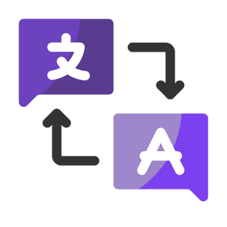
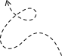

PROJECT
INTRODUCTION
SQL stands for Structured Query Language, which is the set of collection of queries which can be further used for data manipulation challenges.
Imagine talking to a computer like you would to a friend and asking it to suggest specific code snippets to use in program. That's what our project is all about - making it super easy for anyone to talk to a computer and get their code just by giving natural language input.
Natural language to SQL translator tool have features like play ground, multilingual and much more to explore.

Slide 4


PROJECT
ABSTRACT
This project is all about making it easy for people to talk to their computer and get information from big databases. We use Ai/ Ml technology to understand what you say and turn it into the computer's language (SQL). We also have a special "SQL playground" where you can run SQL queries and see results
Why is this important? Well, it helps regular people, not just computer experts, get code they want just by providing input. It's useful for businesses, researchers, students and anyone who using SQL.
In this project, we explain how we're doing this step by step, from understanding your words to providing you output...

Slide 5


PROJECT
MOTIVATION
Our project is motivated by the idea of making it super easy for regular people to talk to their computers and get code snippets from inputing queries in whatever language. This is important because right now, for cross checking our self-written code or to save time behind writing such code snippets.
Our project simplifies the process of asking questions to a database, and we've made it even more fun with the "SQL playground," a place to learn and practice without fear.
Our project aims to write desired output to user by analyzing whatever query inputed..

Slide 6


PROBLEM
DEFINITION
Our project is motivated by the idea of making it super easy for regular people to talk to their computers and get code snippets from inputing queries in whatever language. This is important because right now, for cross checking our self-written code or to save time behind writing such code snippets.
Our project simplifies the process of asking questions to a database, and we've made it even more fun with the "SQL playground," a place to learn and practice without fear.
Our project aims to write desired output to user by analyzing whatever query inputed..

Slide 7

PROJECT
OBJECTIVE
Our project Natural language to SQL translator’s main objective is to provide user SQL code based on their input query & can be further used in coding backend or databases of system.
Our project enables a computer to recognize and analyze users query related only to SQL, any other query will be discarded.
Our project software works by using text analysis, natural language processing and then train that query and show output using ML model.
Playground of our project enables user to run their SQL queries and manipulate data according to their needs. It is for only good practices.

Slide 8










HARDWARE
INTERFACE
Desktop
Internet Connection
Mobile Phone
SOFTWARE
INTERFACE
AI
ML
Django
Python3
AI/ ML
HTML CSS JS
Bootstrap

Slide 9

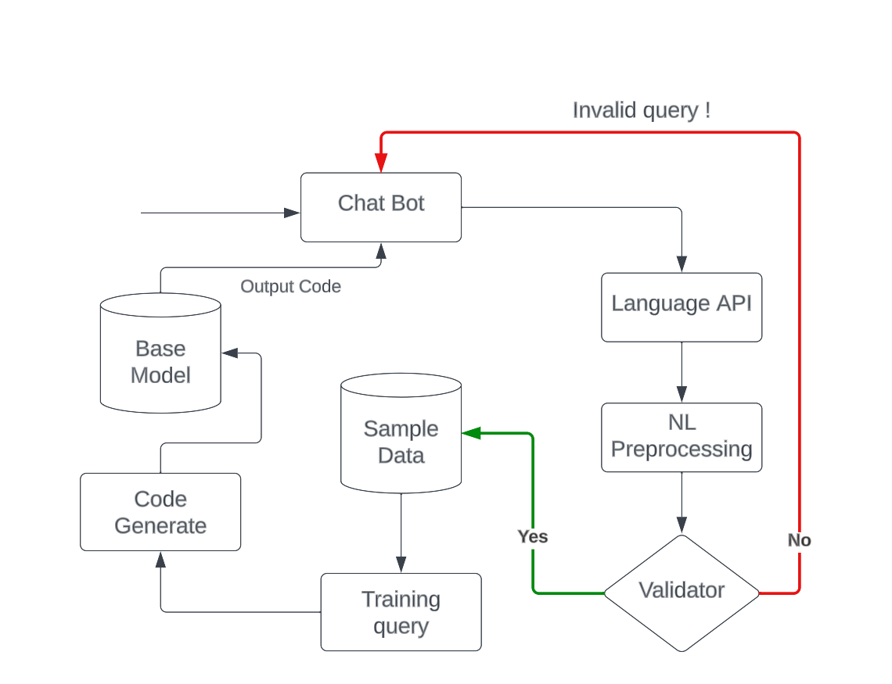

SYSTEM
ARCHITECTURE

Slide 10
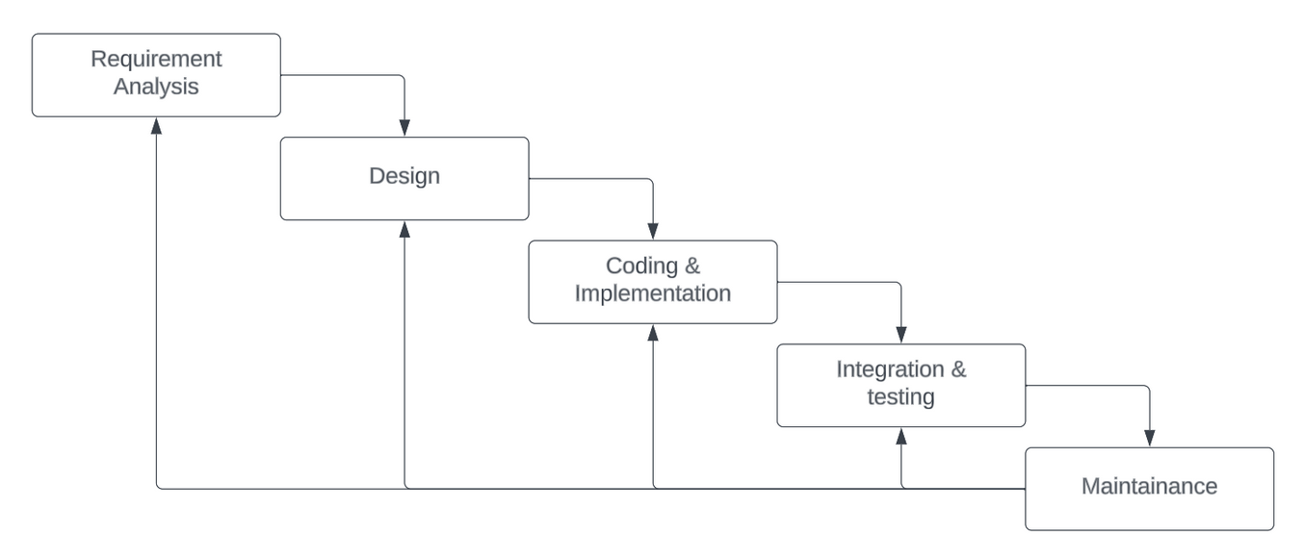
WATERFALL
MODEL

Slide 11

SQLIFY
THANK YOU
Thanking you audience for listening to us
askokc4321@gmail.com

